Slide 1


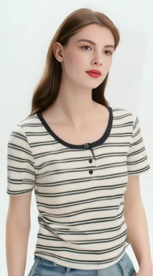
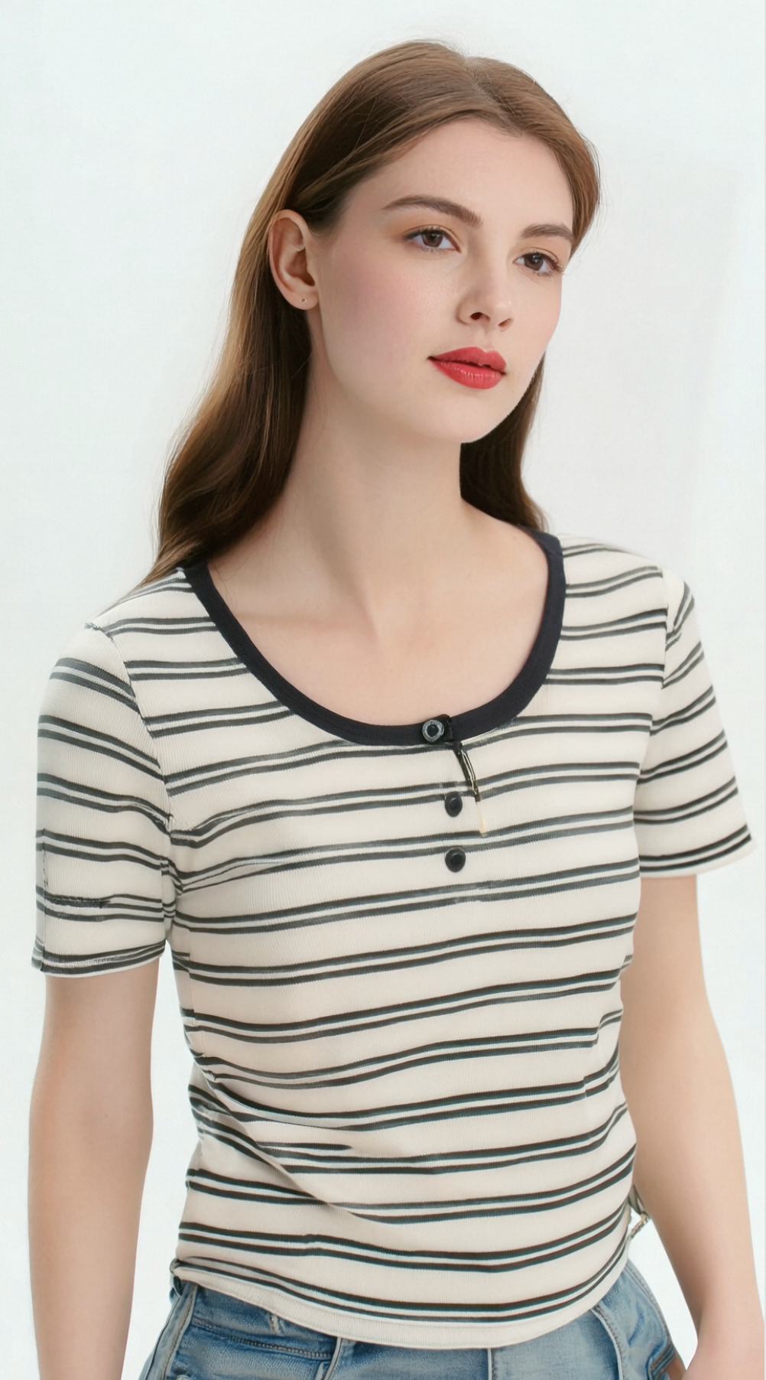
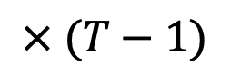
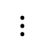
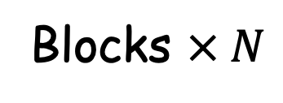
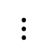
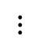
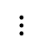
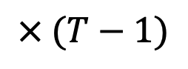
Trainable
Frozen
Add
“A woman with a serene expression is wearing a t-shirt with a round ....”
$$× (T−1)$$
CogVLM2-Video
T5 encoder
$$⋮$$
Cross Attention
Timestep
DiT block
MLP
Text tokens
$$⋮$$
Control feature projector
Connector
VAE encoder
VAE decoder
Video latent
$$⋮$$
Blocks $× N$
Patchify
Vision tokens
$$⋮$$
$$× (T−1)$$
ControlNet
ControlNet
LQ input video
Noise
HQ output video
$$⋮$$

Slide 2

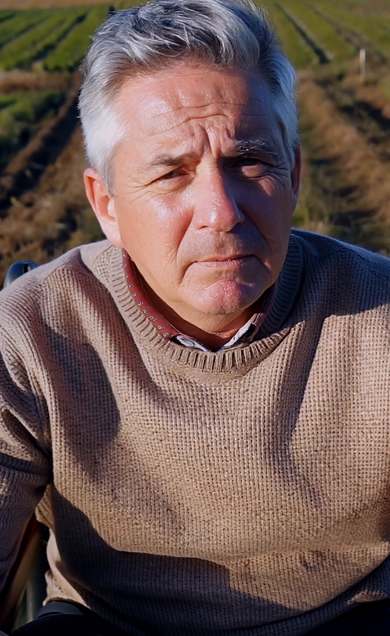
Trainable
Frozen
Add
“A woman with a serene expression is wearing a t-shirt with a round ....”
$$× (T−1)$$
CogVLM2-Video
T5 encoder
$$⋮$$
Cross Attention
Timestep
DiT block
MLP
Text tokens
$$⋮$$
Control feature projector
Connector
VAE encoder
VAE decoder
Video latent
$$⋮$$
Blocks $× N$
Patchify
Vision tokens
$$⋮$$
$$× (T−1)$$
ControlNet
ControlNet
LQ input video
Noise
HQ output video
$$⋮$$

